Slide 1
Illinois Cooperative Work Study Program
Springer Center for Excellence in Internships

Slide 2
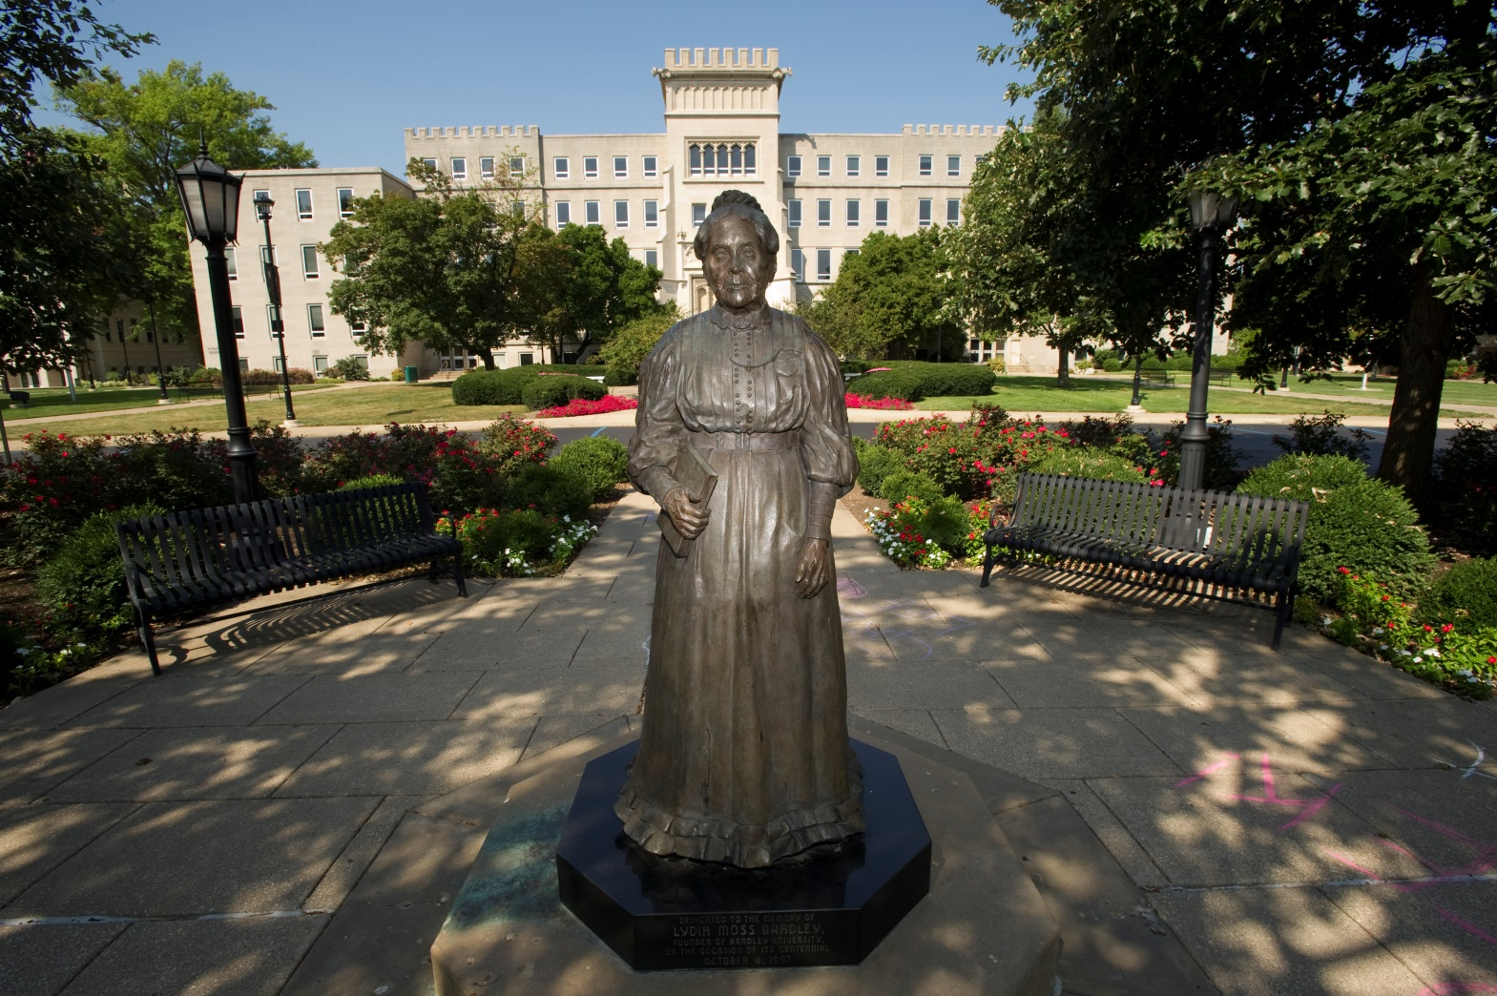
ICWS Supports Bradley’s Mission

Slide 3
A Bit of History…
1964 Engineering Co-op Program Started
1981 Bradley awarded Cooperative Education Demonstration Grant
1982 Established Co-op/Intern Faculty Adv. Board
1985 Formalized a centralized program
1992 Bradley received its first ICWS grant
2008 Dedicated the Springer Center
2011 Recognized by U.S. News & World Report
Notes:
Dawn –
- The significant piece to the history is the award of Title VIII funds in 1981 to build a comprehensive Cooperative Education program.

Slide 4
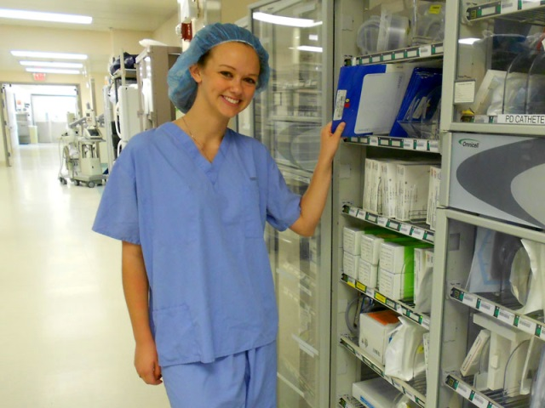
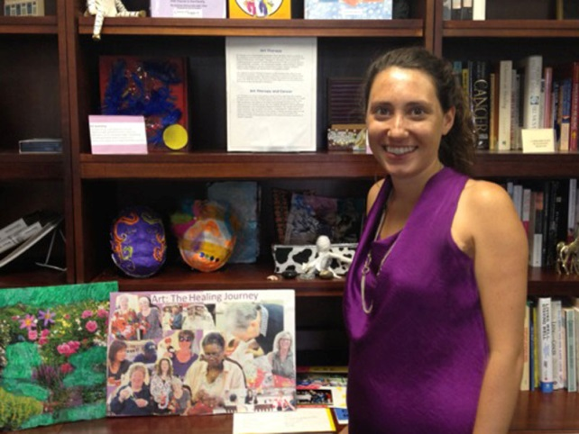
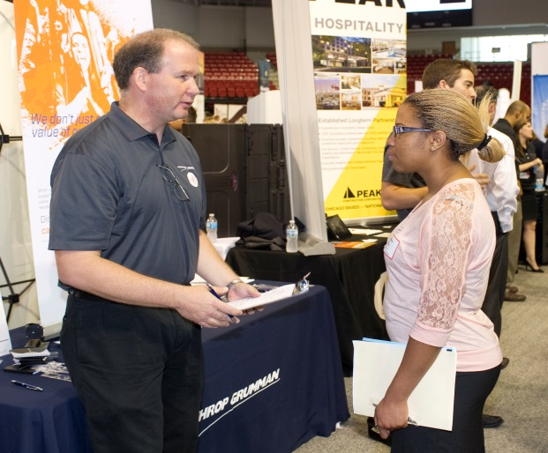
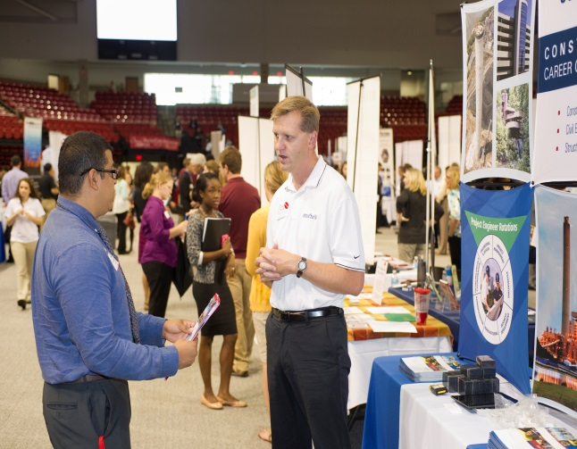
ICWS Strengthens Bradley’s Program

Slide 5
By the Numbers….
23 consecutive years of funding
1,927 total ICWS internship placements
$89,000 in student earnings for FY2013
19-31 employer partners each year

Slide 6
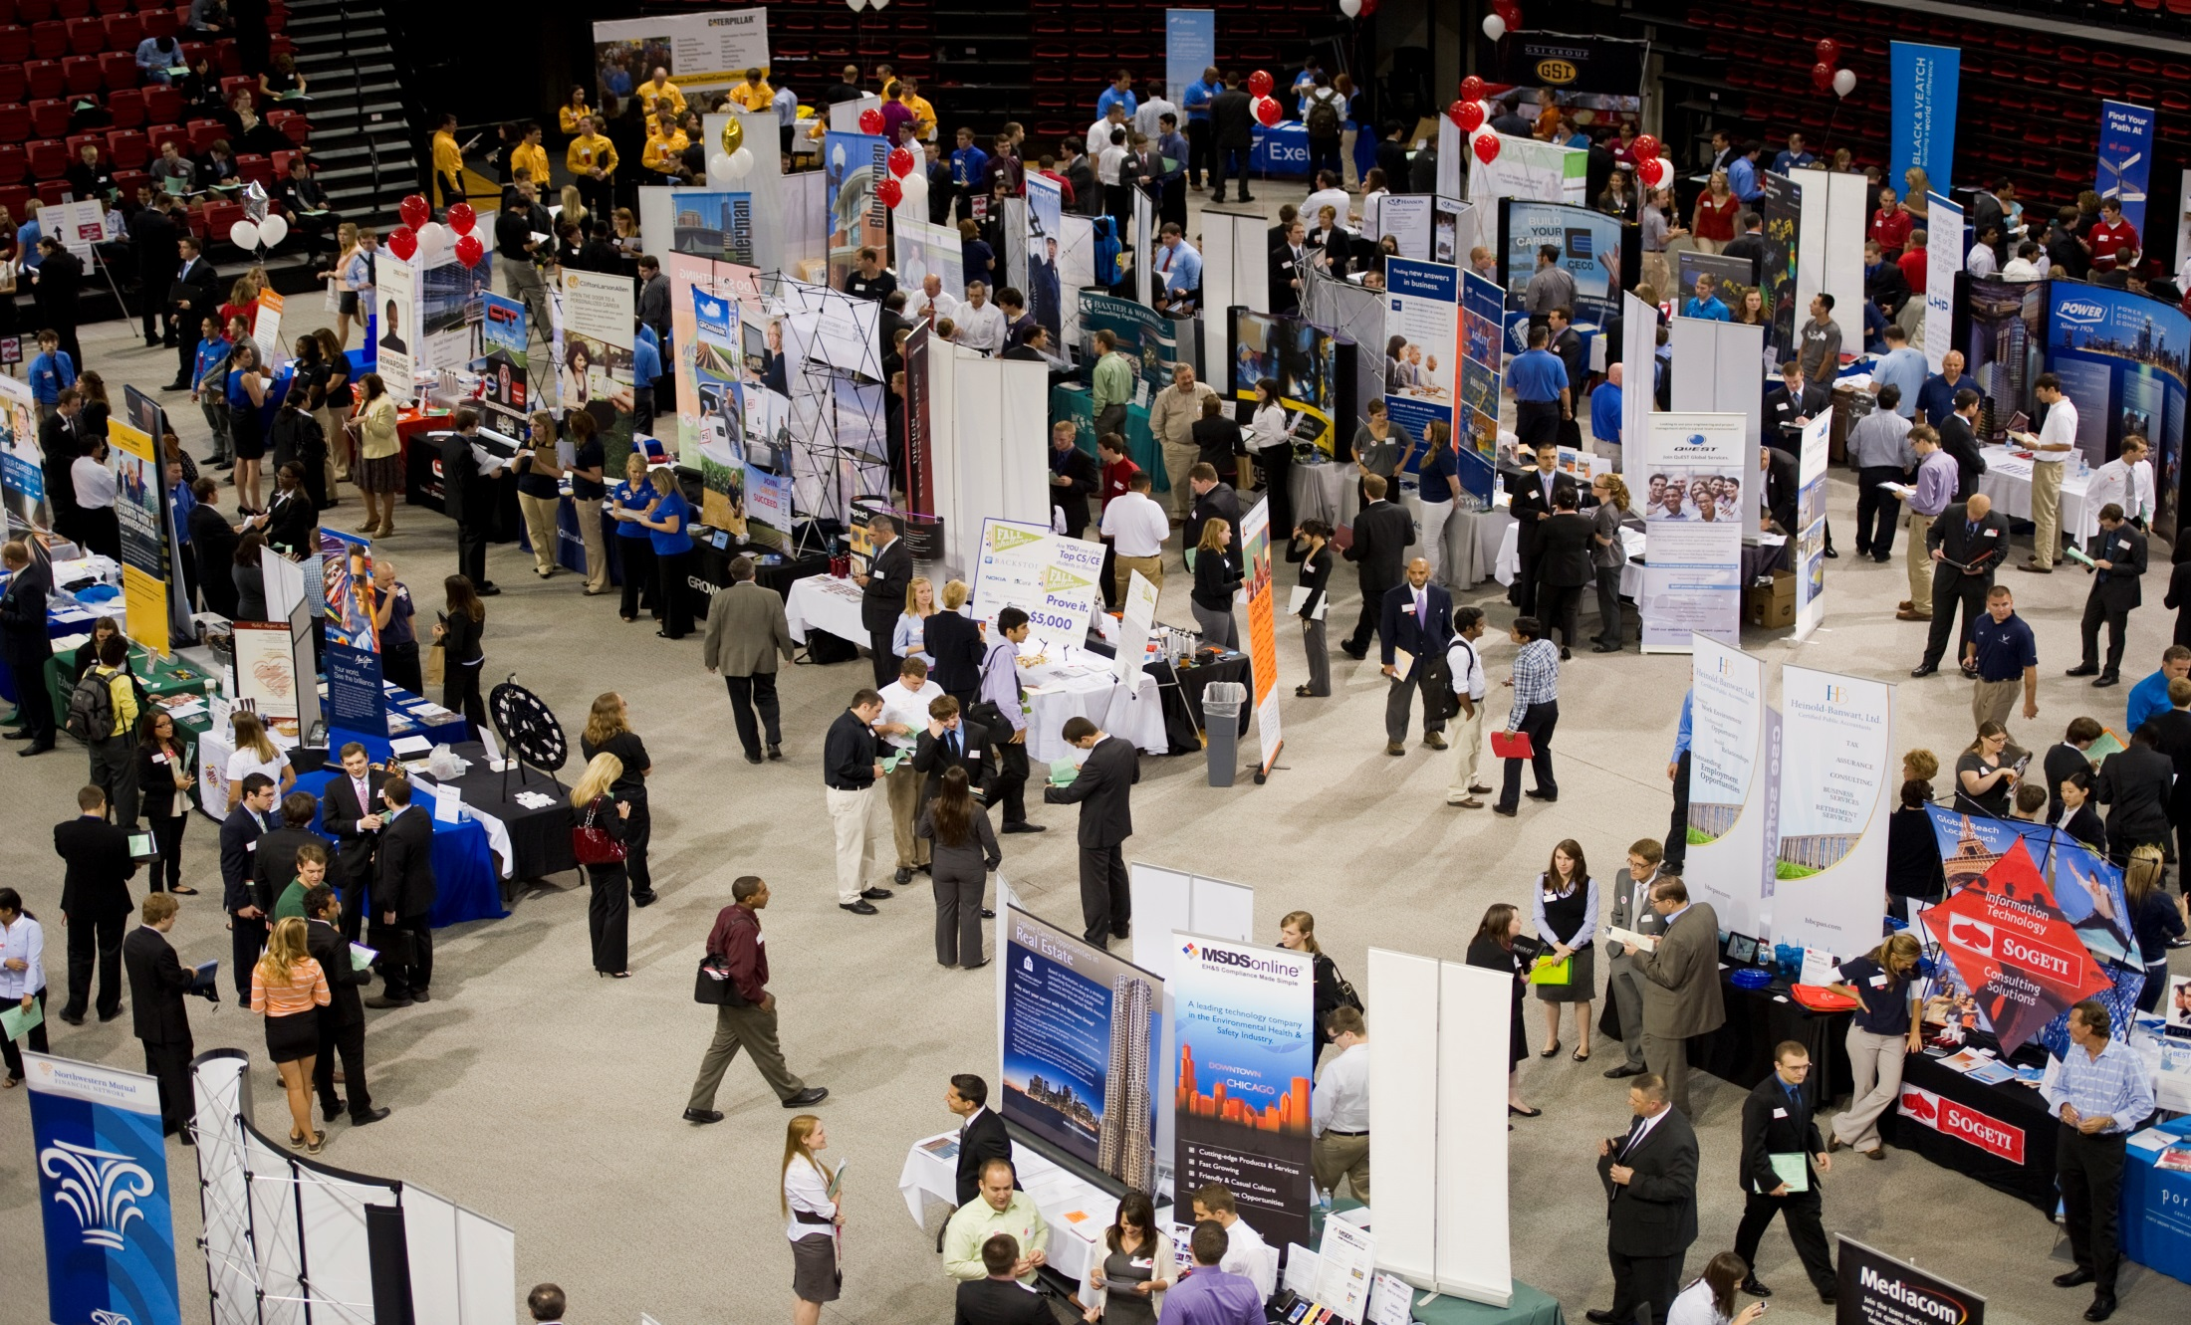
Student & Employer Selection

Slide 7
Internship Courses Administered by the Smith Career Center in cooperation with the Co-op/Intern Faculty Advisory Board
BUS 201, 301 & ATG 605
CFA 301
EHS 301
EGT 210, 310, 410, 510 (Engineering Internships)
CE 200, CON 200, EE 200, IME 200, IMT 200, ME 200 (Engineering Co-ops)
LAS 301

Slide 8
Established Monitoring Process
STUDENTS
Student Learning Agreement Form
Student Pre- and Post-Evaluations
Goals Statement
Reflection Paper
Professional Skills for the Workplace
SPRINGER CENTER
Online Course - Workshops and Resources
Employer Midpoint Check-In
Employer Evaluation
Employer Site Visits

Slide 9
Graduate Outcomes….
86% completed career-related work
96% placement rate
100% placement rate for grant participants
75% of grant participants hired for
permanent employment in Illinois
10 graduates hired by grant employers
(2011-2012 First Destination Study)

Slide 10
Learning Outcomes Assessment

Slide 11
Learning Outcomes Assessment
All comparisons significant at p <0.0001

Slide 12
Learning Outcomes Assessment
Correlations significant at p <0.001

Slide 13
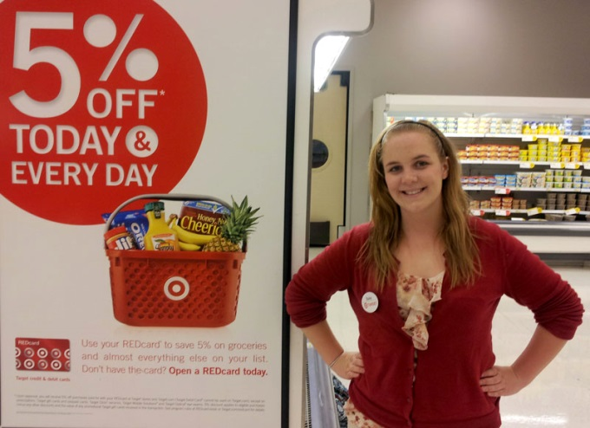
Grant Participant Success Story
Bailey Miller ‘13, Executive Team Leader, Target, Streamwood, Illinois
Interned with The Heartland Partnership

Slide 14
Grant Participant Success Story
Enhanced academic, employment, and community relationships
Reduced reliance on student loans
Provided positive effects on personal and professional growth

Slide 15
Thank You

